Slide 1

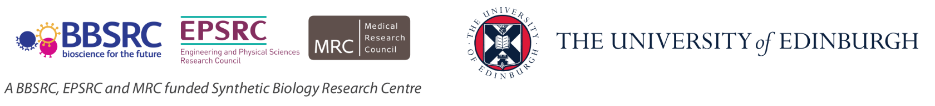
Biological Research
Data Management Team
SBS PhD Induction Dealing with data
Dr Livia Scorza
Dr Tomasz Zieliński
bio_rdm@ed.ac.uk

Slide 2
Course Content
Open Science and FAIR Principles
Organising and Documenting Your Data
Introduction to metadata
Electronic Lab notebooks
Working with files
Introduction to Data Management Planning
Active Data Storage
Data-related resources at the University
Notes:
Alternative to learning objectives

Slide 3

Open Science
Open science is transparent and accessible knowledge
that is shared and developed
through collaborative networks.

Slide 4
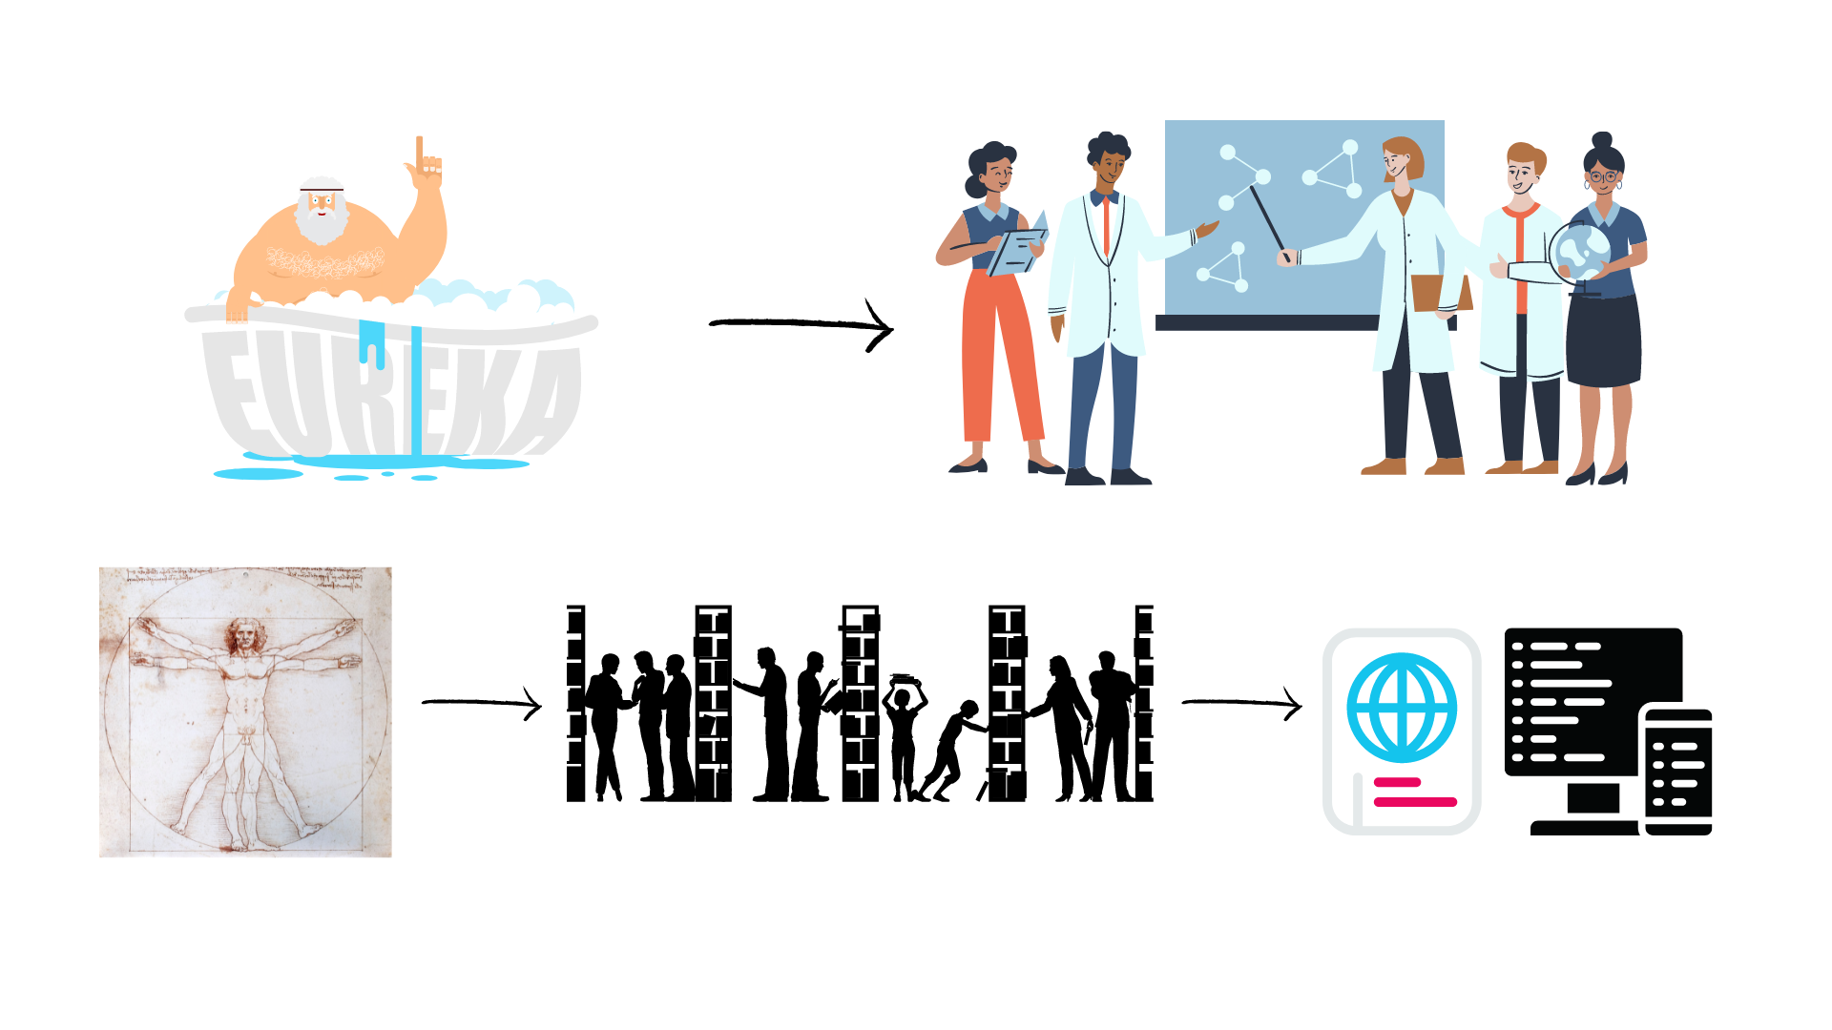
Evolution of Open Science
Level of openness in research

Slide 5






Open Science
Open science is the movement to make scientific research accessible to all levels of society
general public
amateurs
professionals
students
teachers
publications
data
physical samples
software
Digital technologies for diffusing knowledge

Slide 6
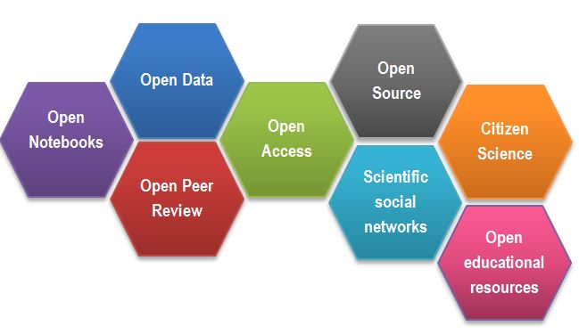
Open Science
CREDITS [1] CC BY

Slide 7
Outcomes of Openness
Collaboration
Speed
Unpulished / negative results
Re-use
Learn by example
Feedback

Slide 8
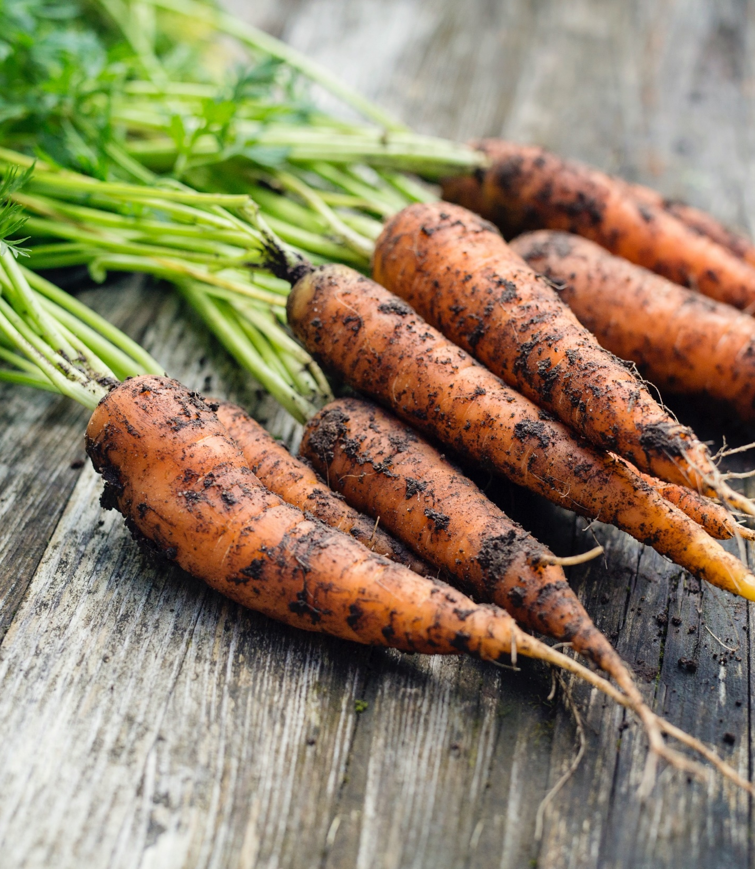
Motivation
“stick”
Large UK funding bodies such as The Wellcome Trust are big supporters of Open Science
“carrot”
….

Slide 9
Your motivators
….

Slide 10
But how (not) to share in practice

Slide 11
Data from publications
…

Slide 12
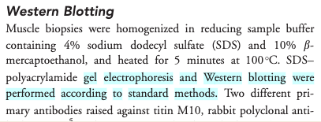
Impossible protocol

Slide 13
Common problems
The first example
the protocol was difficult to find (the loops),
the protocol difficult to access (pay wall),
and not reusable as it lacked the necessary details (dead-end).
The second example not interoperable and reusable
Numerical data as graphs / pdf
Obscure column headers

Slide 14
Common problems
Only averaged data available
No numerical data available
Data tables as PDF files in supporting information
Vendor specific file formats
Links to non existing group websites / databases
Data / Code “on request”

Slide 15

FAIR principles
CREDITS [5] CC BY

Slide 16
FAIR principles
Findable:
persistent identyfiers pointing to the data
descriptions that allow dscovery by both humans and computers
Accessible:
(meta)data retrieval by standard protocols (http)
metadata available even when the data are not
Interoperable:
(meta)data saved in open/common format (interpretable for various tools)
(meta)data should use vocabularies that follow FAIR principles.
Re-usable:
data should be well-described so that they can be replicated and/or combined in different settings
conditions of the reuse should be stated with a clear license

Slide 17
FAIR in biological practice
Findable & Accessible
Deposit data to an external, reputable public repository.
Repositories provide persistent identifiers (PIDs), catalogue options, advanced metadata searching, and download statistics. Some repositories can also host private data or provide embargo periods, meaning access to all data can be delayed.
There are general “data agnostic” repositories, for example: Dryad, Zenodo, FigShare, Dataverse and THE UNIVERSITY’s own DataShare .
Or domain specific, for example: UniProt – protein data, GenBank – sequence data, MetaboLights – metabolomics data.

Slide 18
FAIR in biological practice
Interoperable
Use .csv or .xls files for numerical data. Never share data tables as word or pdf
Provide underlying numerical data for all plots and graphs
Use common file formats (domain specific)
Convert proprietary binary formats to open ones. For example convert Snapgene to Genbank/SBOL, microscopy multistack images to OME-TIFF

Slide 19
FAIR in biological practice
Reusable
describe your data well (good metadata)
write a README file describing the data
provide as many details as possible (prepare good metadata)
use descriptive column headers for the data tables
tidy data tables, make them analysis friendly
use (meta)data formats (e.g. SBML, SBOL)
use commonly known terms and PIDs in descriptions
follow Minimum Information Standards
attach license files

Slide 20
FAIR and You
Citable
Track & Countable
Intelligible
Reproducible
CREDITS [5] CC BY

Slide 21
FAIR example
What makes it FAIR
https://doi.org/10.5281/zenodo.6339631
CREDITS [5] CC BY

Slide 22
Break

Slide 23
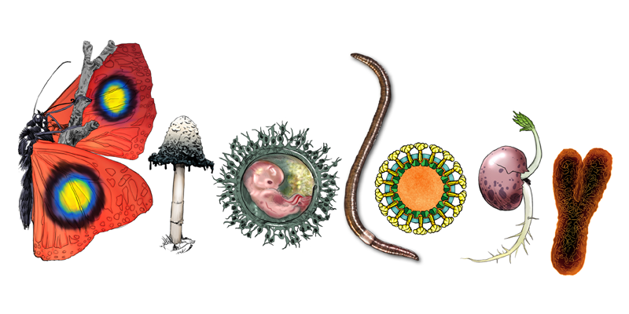
What is data?
Data can be defined as facts, figures, or information that is collected, used and stored for reference or analysis
Information about physical samples (patient):
animal/ plant tissue (live, in culture, frozen, etc)
bacterial / yeast stocks etc
Quantitative / numerical data: Spreadsheets (tables), csv files
Images (pictures, microscopy images, 3D scans)
Code (Software programs, analysis codes, algorithms)
DNA/RNA sequences (plasmids, sequencing files, etc)
Protocols (recipes, laboratory and measurement protocols)
Biological data is diverse!

Slide 24
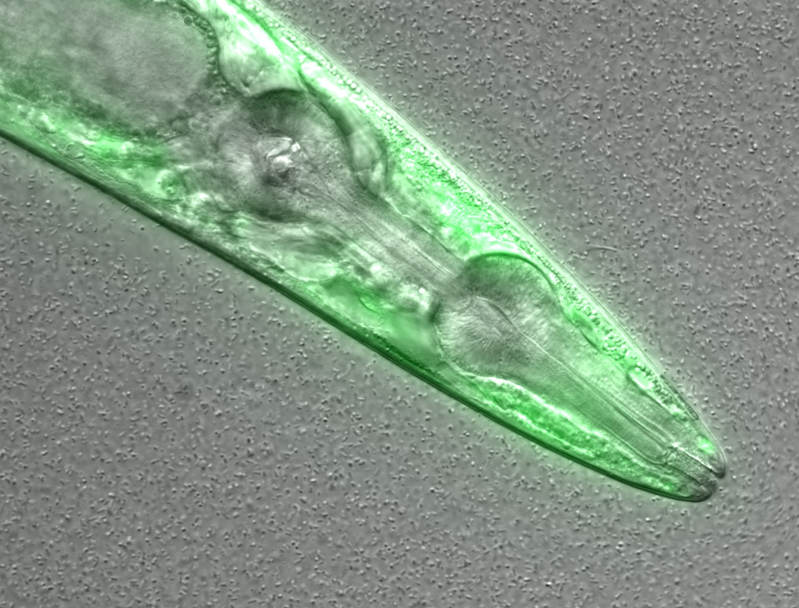
What information can you guess without the associated description (metadata)?
Figure credits: María Eugenia Goya
Notes:
Image metadata
Name: OP50 D10Ad_06.czi Image ID: 3485 Owner: Maria Eugenia Goya ORCID: 0000-0002-5031-2470
Acquisition Date: 2018-12-12 17:53:55 Import Date: 2020-04-30 22:38:59 Dimensions (XY): 1344 x 1024 Pixels Type: uint16 Pixels Size (XYZ) (µm): 0.16 x 0.16 x 1.00 Z-sections/Timepoints: 56 x 1 Channels: TL DIC, TagYFP ROI Count: 0
Tags: time course; day 10; adults; food switching; E. coli OP50; NL5901; C. elegans
Dataset metadata
Name: Figure2_Figure2B Dataset ID: 263 Owner: Maria Eugenia Goya ORCID: 0000-0002-5031-2470
Description: The datasets contains a time course of α-syn aggregation in NL5901 C. elegans worms after a food switch at the L4 stage:
E. coli OP50 to OP50 Day 01 adults Day 03 adults Day 05 adults Day 07 adults Day 10 adults Day 13 adults
E. coli OP50 to B. subtilis PXN21 Day 01 adults Day 03 adults Day 05 adults Day 07 adults Day 10 adults Day 13 adults
Images were taken at 6 developmental timepoints (D1Ad, D3Ad, D5Ad, D7Ad, D10Ad, D13Ad)
* Some images contain more than one nematode.
Each image contains ~30 (or more) Z-sections, 1 µmeters apart. The TagYFP channel is used to follow the alpha-synuclein particles. The TL DIC channel is used to image the whole nematode head.
These images were used to construct Figure 2B of the Cell Reports paper (https://doi.org/10.1016/j.celrep.2019.12.078).
Creation date: 2020-04-30 22:16:39
Tags: protein aggregation; time course; E. coli OP50 to B. subtilis PXN21; food switching; E. coli OP50; 10.1016/j.celrep.2019.12.078; NL5901; C. elegans

Slide 25
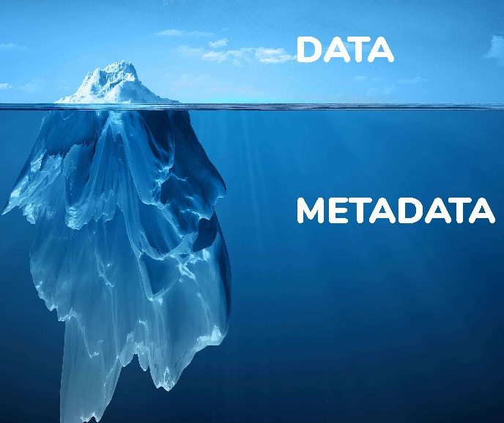
What is metadata?
Metadata is the data about data!
Description / information of the data
The data has little or no meaning without metadata
It should be continuously added to your research data
(not just at the beginning or end of a project!)

Slide 26
What information would you need to re-use that data?
Exercise
Suggestions:
Author
What it is
What was measured
Figure credits: María Eugenia Goya
Notes:
Image metadata
Name: OP50 D10Ad_06.czi Image ID: 3485 Owner: Maria Eugenia Goya ORCID: 0000-0002-5031-2470
Acquisition Date: 2018-12-12 17:53:55 Import Date: 2020-04-30 22:38:59 Dimensions (XY): 1344 x 1024 Pixels Type: uint16 Pixels Size (XYZ) (µm): 0.16 x 0.16 x 1.00 Z-sections/Timepoints: 56 x 1 Channels: TL DIC, TagYFP ROI Count: 0
Tags: time course; day 10; adults; food switching; E. coli OP50; NL5901; C. elegans
Dataset metadata
Name: Figure2_Figure2B Dataset ID: 263 Owner: Maria Eugenia Goya ORCID: 0000-0002-5031-2470
Description: The datasets contains a time course of α-syn aggregation in NL5901 C. elegans worms after a food switch at the L4 stage:
E. coli OP50 to OP50 Day 01 adults Day 03 adults Day 05 adults Day 07 adults Day 10 adults Day 13 adults
E. coli OP50 to B. subtilis PXN21 Day 01 adults Day 03 adults Day 05 adults Day 07 adults Day 10 adults Day 13 adults
Images were taken at 6 developmental timepoints (D1Ad, D3Ad, D5Ad, D7Ad, D10Ad, D13Ad)
* Some images contain more than one nematode.
Each image contains ~30 (or more) Z-sections, 1 µmeters apart. The TagYFP channel is used to follow the alpha-synuclein particles. The TL DIC channel is used to image the whole nematode head.
These images were used to construct Figure 2B of the Cell Reports paper (https://doi.org/10.1016/j.celrep.2019.12.078).
Creation date: 2020-04-30 22:16:39
Tags: protein aggregation; time course; E. coli OP50 to B. subtilis PXN21; food switching; E. coli OP50; 10.1016/j.celrep.2019.12.078; NL5901; C. elegans

Slide 27
What is metadata?
Adding metadata
Think as a consumer of your data not the producer!
What information would another researcher need to understand or reproduce your data?
Name of data creator/ Title
Project purpose and experimental hypothesis
Biological material, context, details on data acquisition, experimental conditions, etc.

Slide 28
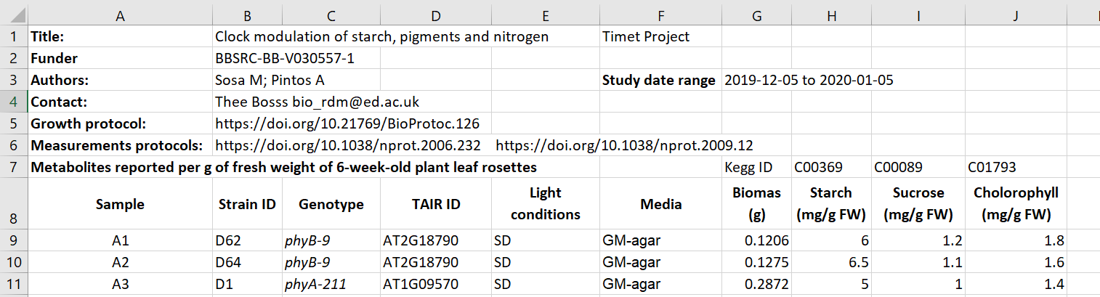
Metadata examples (tables or readme)
Metadata embedded in spreadsheet
Figure credits: Tomasz Zielinski and Andrés Romanowski

Slide 29
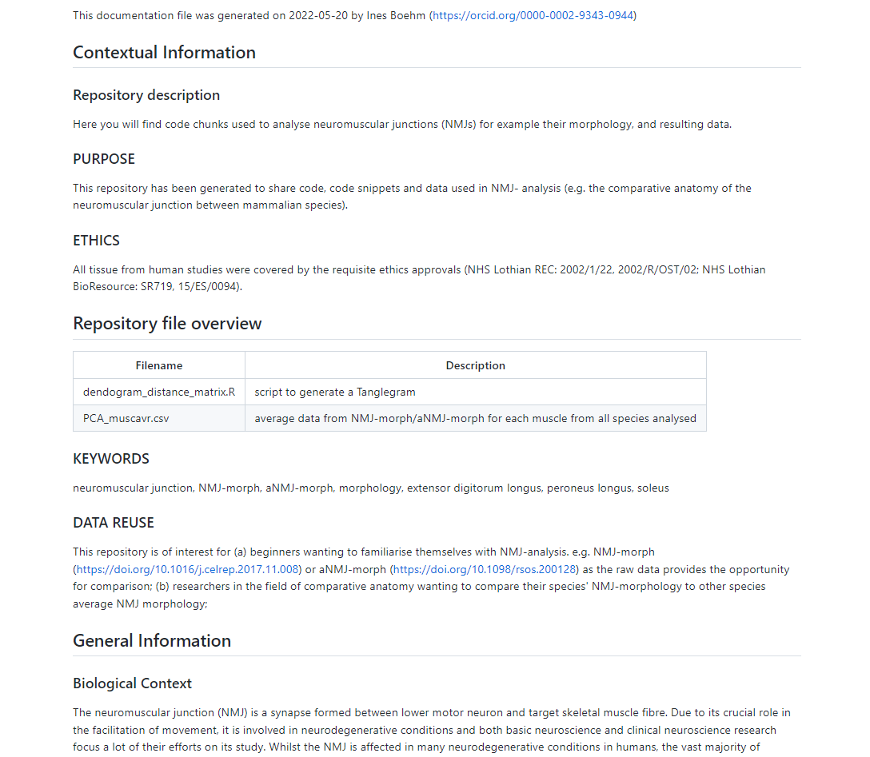
Metadata examples (tables or readme)
Metadata as README file
https://github.com/Boehmin/NMJ_analysis/blob/main/README.md

Slide 30
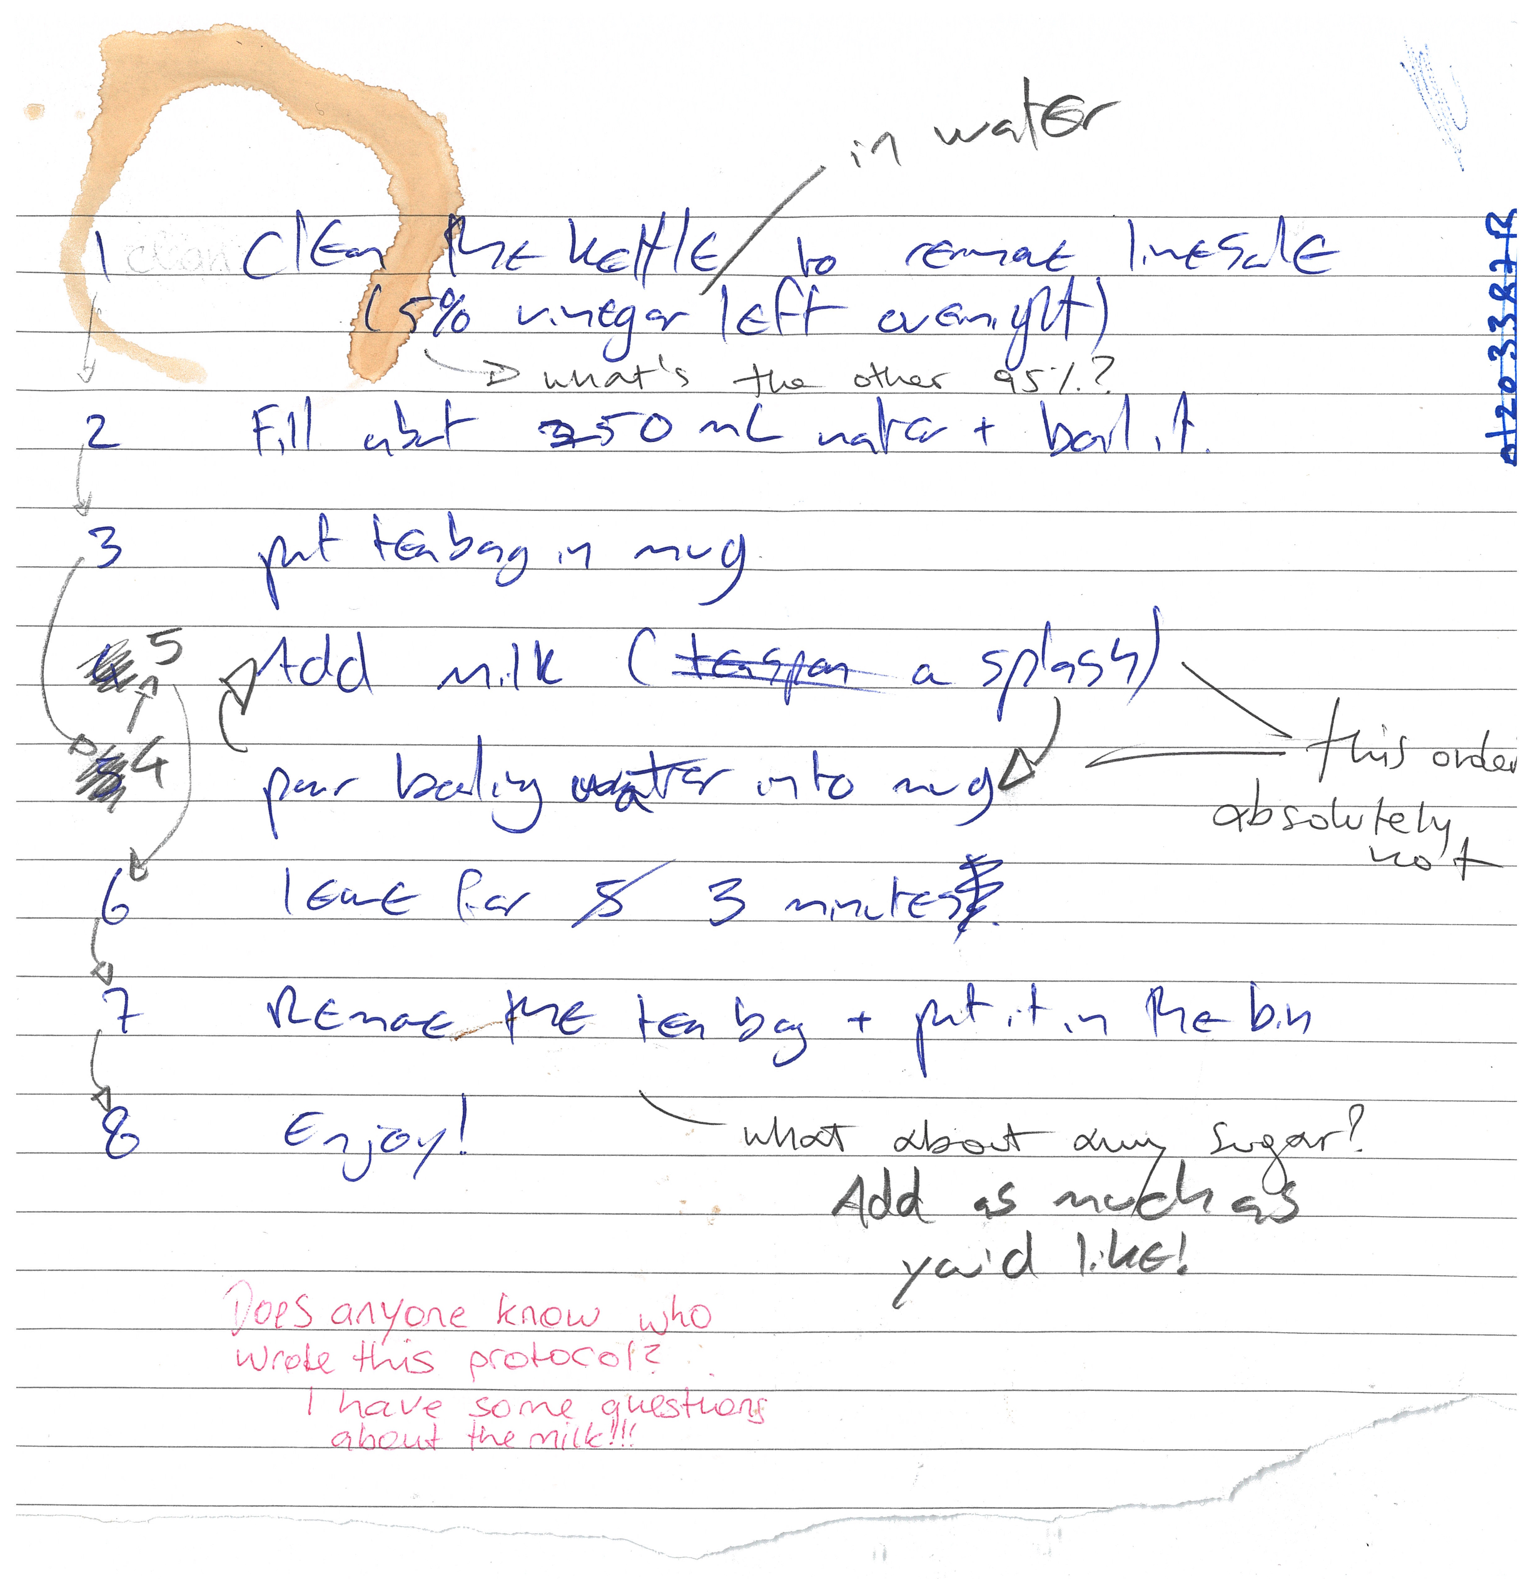
It is time to make ourselves a cup of tea.
Here’s a peer-reviewed protocol
for making tea
Figure credits: Dr Ines Boehm and Ben Thomas

Slide 31

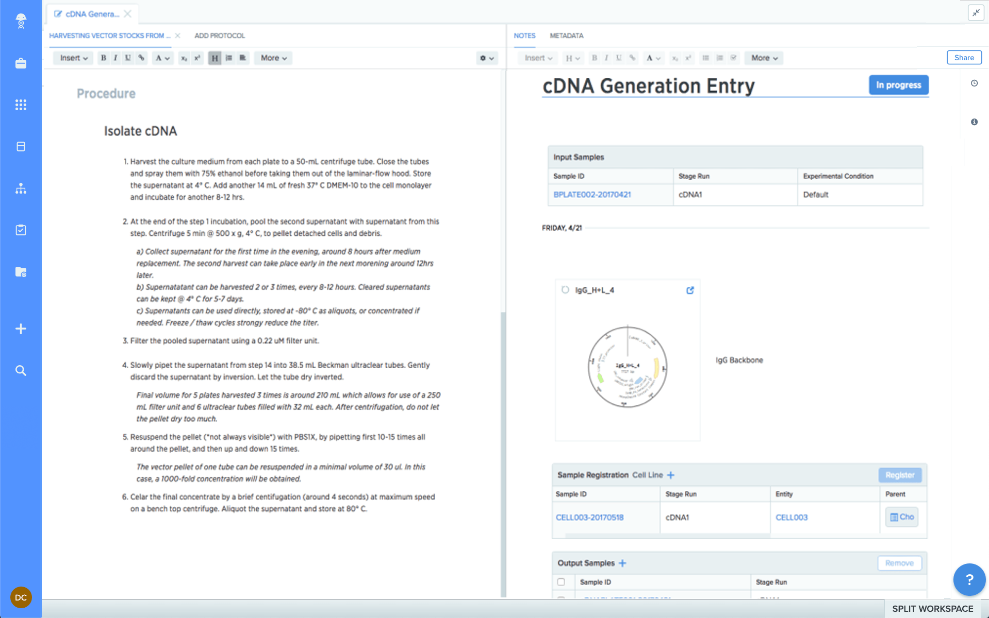
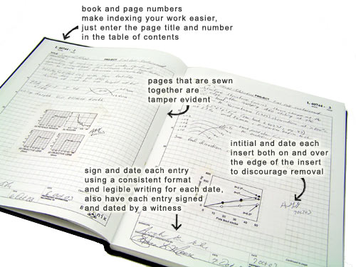
Paper vs ELN

Slide 32
Paper
ELN
Your data is organised and searchable​
Allows off-site archiving​
You can have templates (e.g.: protocols / assay / entries )​ - Easy to copy data entries
Can be shared instantly ; global access within a group​
Doesn’t take up physical space (no record rooms/folders)​
Regular backups​
does not require internet​
directly draw on your records​
Pros
​Can be lost or damaged​
Handwriting not always intelligible ​
Hard to edit and share​
Hard to reuse information​
Not findable/ accessible
Cons
Pros
Requires internet access​
Better if you have a gadget such as a tablet
Cons

Slide 33
Good Lab Records
Both protocols and laboratory records need to be detailed and kept accurate and complete.
Laboratory Notebooks
contain all relevant details (what, who, when why and how)
which project(s) is the record part of
information on lot/batch numbers
what happened and what did not happen (data, including images)
how you processed and analysed the data
your interpretation (and the interpretations of others if important) and next steps in the project based on these results
should be well organised for ease of navigation (indexed, labelled, catalogued)
accurate and complete: include all original data and important study details (metadata).
Protocols
who created the protocol if not you
complete and detailed instructions describing why and how to do an experiment
what special materials and instruments are being used and where they were obtained
health and safety advice and how to dispose of waste
allow repetition of your procedures and studies by yourself and others

Slide 34

Example of good record keeping
https://benchling.com/s/etr-0FdV1H0rpWeHk4H72NOg/edit
Aims of the experiment
Samples are described
Protocols are written down and referenced
Result figures and description
What worked and what did not; potential solutions
Final conclusions

Slide 35
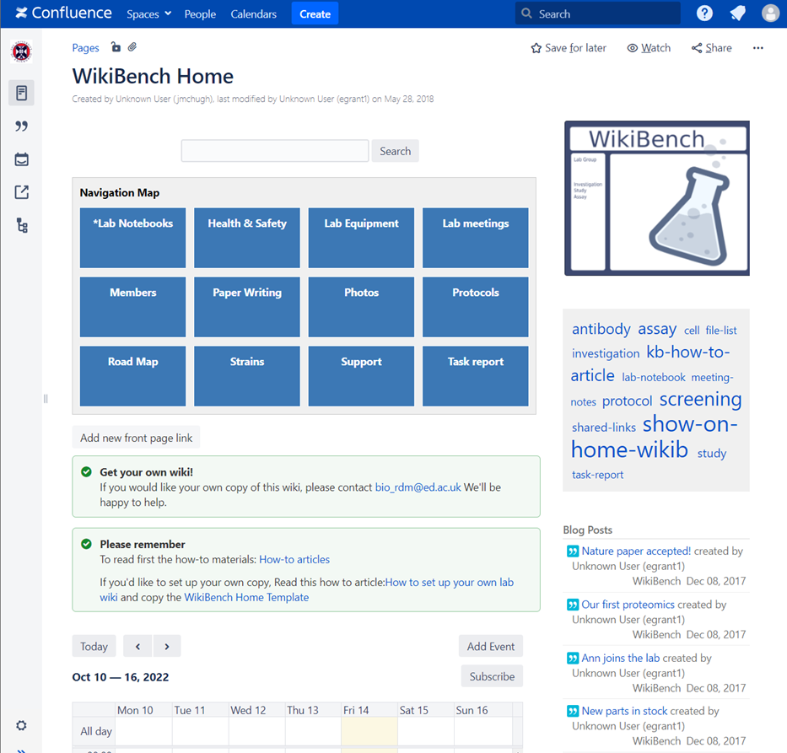



Which ELNs are used in SBS?
WikiBench (UoE Wiki)

Slide 36
How do I choose one?
RDM as part of the workflow
Does my group already use one?
Yes
No
Use that one!
Things to take into account:
Cost
Traceable? (data cannot be deleted and are time stamped)
Where are the servers located?
Can the data be downloaded?
What happens to the data when someone leaves the group?
bio_rdm@ed.ac.uk​
Notes:
Acquire description at earlier stages, split over the stages

Slide 37


ELNs Resources from BioRDM
https://www.wiki.ed.ac.uk/x/f0SkGw
Hands-on tutorial on Benchling:
https://www.wiki.ed.ac.uk/display/RDMS/Benchling+tutorial+and+resources
bio_rdm@ed.ac.uk​
Notes:
Acquire description at earlier stages, split over the stages

Slide 38

Working with files

Slide 39
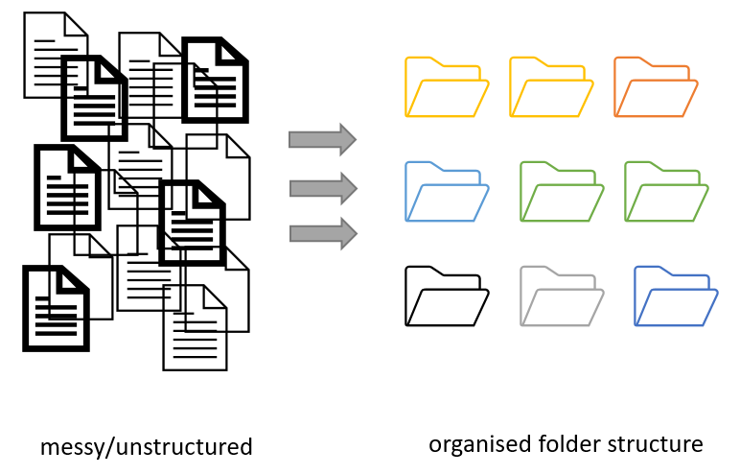
Project organization
Figure credits: Andrés Romanowski

Slide 40
Consistent naming and organization of files in folders has two main goals:
Find files quickly
Ability to tell the file content without opening it

Slide 41
It is important to develop standardized, naming convention
consistent
encoding of experimental factors
meaningful to you and your collaborators
give you a sense of the content
easily identify if something is missing

Slide 42
Naming files
Do’s:
Include date in the name. Use YYYY-MM-DD or YYYYMMDD format, eg. 20210920 Add date at the end of the file UNLESS you organize files chronologically
Include version number (if applicable) (orthogonal to date) Use leading zeroes (i.e.: v005 instead of v5)

Slide 43
Naming files
Do’s:
Encode biological or experimental relevant information, concisely, data category, etc. Example information to include:
sample, site, patient id
drug treatments, doses, names
environmental conditions
genotypes, markers,
technique
Data operation: normalized, cleaned, detrended, clustered

Slide 44
Naming files
Do’s:
Add leading zeros to numerical values
Add prefixes to numerical values: eg. S003, TR005

Slide 45
Naming files
Do’s:
Make sure the file format extension is present at the end of the name (e.g. .docx, .xlsx, .mov, .tif)
Add a PROJECT_STRUCTURE (README) file in your top directory which details your naming convention, directory structure and abbreviations

Slide 46
Naming files
Don'ts:
Avoid using spaces (use _ or - instead)
Avoid using commas and special characters (e.g. ~ ! @ # $ % < > ?[ ] { } ‘)
Avoid using language specific characters (e.g óężé)

Slide 47
Naming files
Don'ts:
Avoid using long names (should not exceed 30 characters)
Avoid repeating information from parent elements ELN_MI_20200101.tiff in Electron_Microscopy folder
Avoid using deep paths with long names (i.e. deeply nested folders with long names)

Slide 48
Exercise 2:
A good name

Slide 49
Folders vs Files
Folders permit grouping relevant data together
Folders help to keep files names short

Slide 50
Exercise 6:
Folders vs Files

Slide 51
Exercise 6
A)
Datasets for publication (grouped by raw data, results, scripts)
Pipelines (inputs, outputs, scripts and workflow
B)
„By Figure” or „By analisys” – data and related code next to each other
C)
„By patient” (sample/subject) ... based on Brain Imaging Data Structure BIDS
D)
„By conditions/treatment” – mulitple biological materials under various experimental conditions

Slide 52
Keeping safe your project files and folders
Back up (almost) everything created by a human or recorded by a machine as soon as it is created.
Always backup your files in 3 places, at least one should be off-site.
USB sticks are a failure-prone option and are not a valid solution for backup of scientific data
A robust backup cannot be achieved manually – the University gives you DataStore
Notes:
Do you know how and where to keep 3 copies of your data which are always up to date?
Secure data preservation is very difficult to achieve without institutional support and know-how. One option is cloud storage, but not all data may be put in a public cloud.
You should always check your institutional guidelines and what solutions are available in your organisation.

Slide 53
Sharing as part of the workflow
CREATING DATA
RE-USING DATA
PROCESSING DATA
Time and effort
SHARING
DATA
ANALYSING DATA
PRESERVING DATA
work necessary to make outputs suitable for sharing

Slide 54
Sharing as part of the workflow
CREATING DATA
RE-USING DATA
PROCESSING DATA
Time and effort
SHARING
DATA
ANALYSING DATA
PRESERVING DATA
work necessary to make outputs suitable for sharing
standard research operations

Slide 55
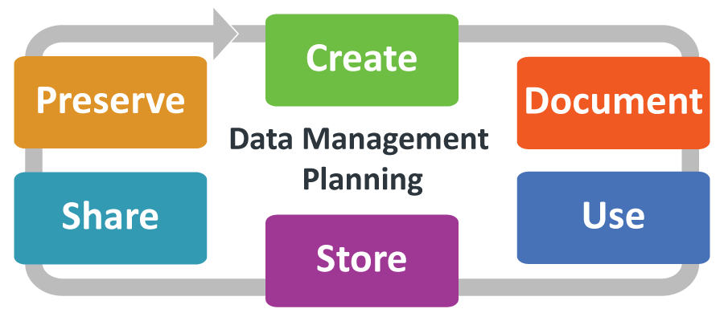
Data Management Planning
Notes:
UK Data Service Research Data Management guidance: https://ukdataservice.ac.uk/learning-hub/research-data-management/

Slide 56
Data Management Planning: What? Why? How?
What: thinking what data you will generate
Types of data, format, volume of the data
How: thinking about how you will
Organise, describe, securely store, and back your data up
Where: to ensure your data is available for replication re-use:
archiving, publishing, conditions of re-use
Tool: DMPOnline https://dmponline.ed.ac.uk
Notes:
How manage: organise, document, store, back-up.
How share and preserve: make data available for verification, replication, re-use.
Plan to prevent loss: HD failure, accidental delete, cat peeing on laptop.
Plan to prevent unauthorised access of sensitive/personal data.
DMPOnline:
Funder Templates
Plan broken down into sections:
data creating/collecting: size, format, type
documentation and metadata
quality assurance processes/standards
storage and back up plans
security measures for sensitive data
how, where, when share it (on publication)
how preserve
Includes lots of guidance for each section : funders / UoE /Data Curation Centre.

Slide 57
Writing a DMP for your Research
Hands-on workshop
Understand the necessity/benefits of producing a DMP!
Discover how to register for and use DMPonline!
Draft a basic DMP!
Find course dates and register: https://www.ed.ac.uk/is/data-training
(go to workshops)

Slide 58
Your musts
According to policies (the School, the University and the funders):
You are responsible for safety of your data (both storage and access)
You have to have DMP for your project
You have to publish with Open Access
You have to make available all the data underlying publications

Slide 59
You want to
Have as many public outputs as possible:
Datasets in public repositories
Public protocols
Code packages
Public engagement
Involvment in Community groups, student groups etc
for your Narrative CVs

Slide 60
Narrative CVs are comming
Generation of Knowledge
Development of Individuals and Collaborations
Supporting Broader Society and the Economy
Supporting the Research Community

Slide 61
Narrative CV
A broad definition of ‘output’ is used, such as datasets, patents and software.
Special attention is paid to Open Science, which outputs are openly available.
New metrics: retweets, online views and downloads, discussions, presence in mass media technology platforms

Slide 62
It is easier to be prepared than to fake it
It takes time to make the outputs public
The quality of open outputs is easy to assess
Timestamps

Slide 63
University resources for data management
BioRDM wiki
https://www.wiki.ed.ac.uk/display/RDMS
(demo)
RDS page
https://www.ed.ac.uk/information-services/research-support/research-data-service

Slide 64
University resources for data management
UoE DataStore
looks like your computer disk (a network drive)
free (250GB + 250GB per student)
accessible from all computers
off-site backup and versioning/history of the files
easy sharing within the University
Dropbox like access vis DataSync

Slide 65
University resources for data management
UoE DataStore
looks like your computer disk (a network drive)
free (250GB + 250GB per student)
accessible from all computers
off-site backup and versioning/history of the files
easy sharing within the University
Dropbox like access vis DataSync
Please Use DataStore

Slide 66
University resources for data management
UoE DataStore - using
Group space (\\csce.datastore.ed.ac.uk\csce\biology\groups\YOUR-GROUP)
Private (\\csce.datastore.ed.ac.uk\csce\biology\users\YOUR_LOGIN)
Use group space for data!

Slide 67
University resources for data management
UoE DataStore - using
You need VPN to connect from home
Depending on network drive may be tricky for very large files
Instructions how to use:
https://www.ed.ac.uk/information-services/computing/desktop-personal/connect-uni-file-storage
BioRDM wiki (recipies for workflows)

Slide 68
University resources for data management
Sharepoint / OneDrive
https://uoe-my.sharepoint.com
For documents, presentations, raports etc
Excellent for collaborative work on shared documents
Online versions of Word / Excel
Your desktop Word can directly sync with sharepoint files

Slide 69
University resources for data management
UoE WIKI
https://www.wiki.ed.ac.uk
For project websites, making notes, organize files,
even a simple ELN
https://www.wiki.ed.ac.uk/display/RDMS

Slide 70
University resources for data management
DMPOnline
https://dmponline.ed.ac.uk
Protocols.io
https://www.protocols.io/
(university pays for full version)

Slide 71
University resources for data management
for CODE use GIT
(you need to learn it though)
Free github (https://github.com)
The University one (https://git.ecdf.ed.ac.uk)

Slide 72
University resources for data management
UoE DataShare
https://datashare.ed.ac.uk/
for sharing public datasets (possible embargo period)
unlimited, free storage (250GB per dataset)
DOI
automatically creates records in your personal profile (UoE PURE)

Slide 73
FAIR in (bio) practice - workshop
Introduction to Open Science and FAIR
IP, Licensing and Openness
Metadata
Ontologies
(Meta)data in Excel
Record keeping
Working with files
Reusable analysis - Jupyter
Version control
Templates
Public repositories
Writing Data Management Plans

Slide 74
BioRDM workshop
FAIR in (bio) practice
22-25 November in the afternoons
https://edcarp.github.io/2022-11-22_ed-dash_fair-bio-practice/

Slide 75
Please complete the feedback section at the end of the pad:
https://pad.carpentries.org/SBS-PHD-2022-10-19

Slide 76

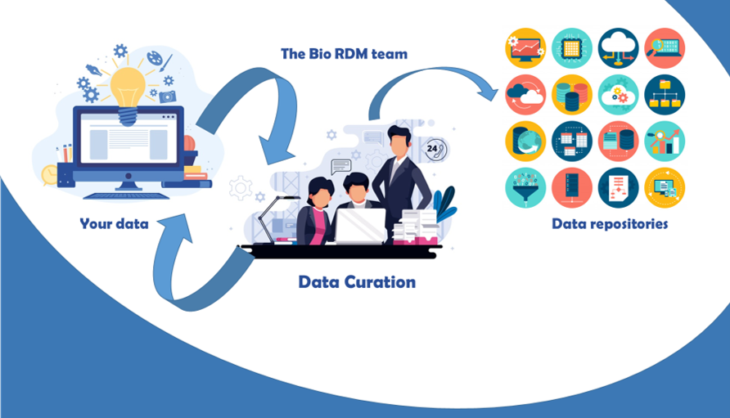
Need help? Just come talk to us!
Biological Research
Data Management Team
RDM as part of the workflow
bio_rdm@ed.ac.uk
https://www.wiki.ed.ac.uk/display/RDMS/
Notes:
Acquire description at earlier stages, split over the stages

